Slide 1
Lecture 1 Phenomenon-driven understanding for deep learning
Zhi-Qin John Xu 许志钦
Shanghai Jiao Tong University
Wednesday, November 13, 2024

Slide 2
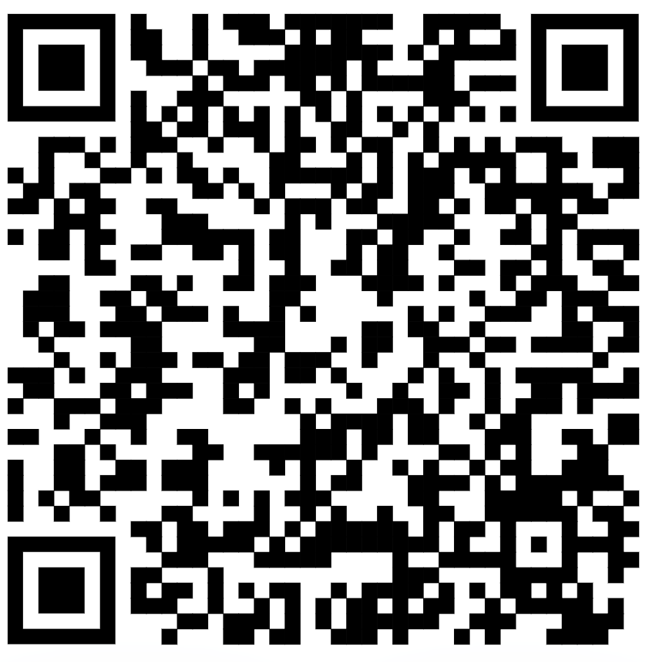
Topics
We will cover the following topics:
Introduction to Phenomenon-driven understanding
Low-frequency bias in output space during training (frequency principle/spectral bias)
Neurons in the same layer tend to be similar during training (neuron condensation/alignment)
Reasoning of transformer-based language models
《深度学习导论与理解》

Slide 3
Introduction to Phenomenon-driven understanding

Slide 4
What is deep learning?

Slide 5
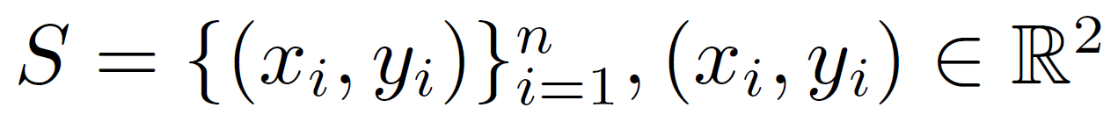
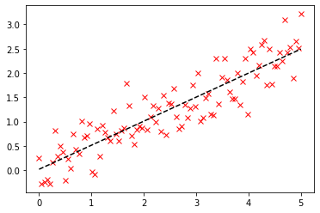
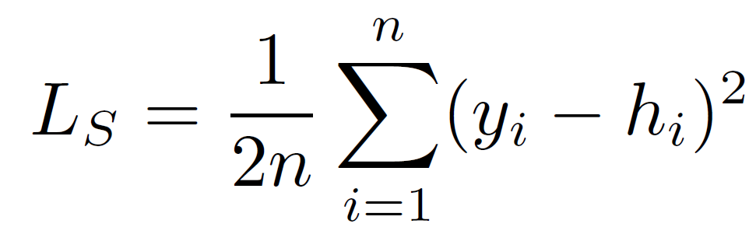
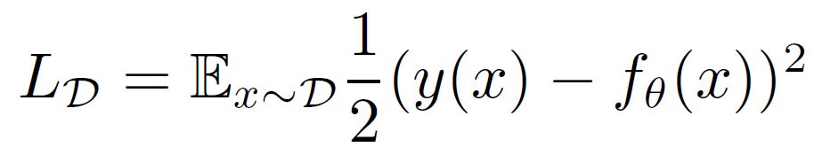
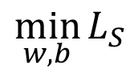
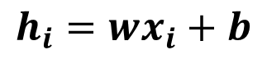
Linear regression
Data set:
Model:
$$h_{i}=wx_{i}+b$$
Loss/Risk:
Empirical risk minimization:
$$\min_{w,b}{L_{S}}$$
Generalization error: loss on test data set (not for training)

Slide 6
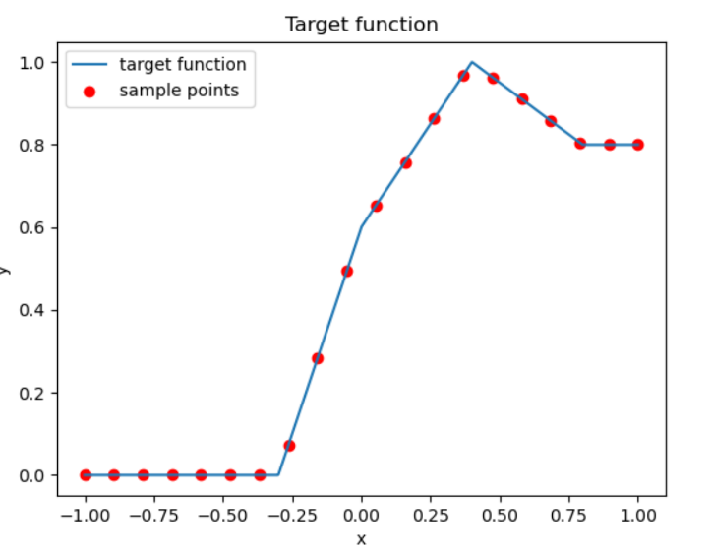
Linear regression
Data set:
Model:
$$h_{i}=wx_{i}+b$$
?
Loss/Risk:
Empirical risk minimization:
$$\min_{w,b}{L_{S}}$$
Generalization error: loss on test data set (not for training)

Slide 7
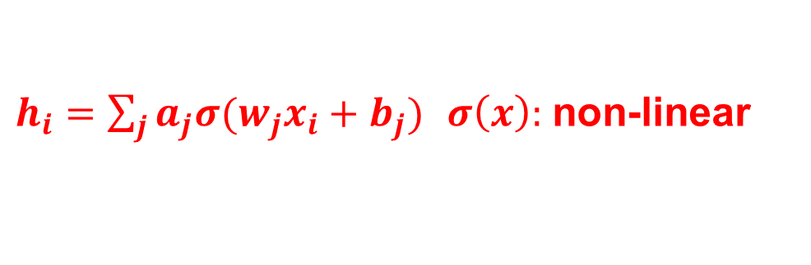
Neural network regression
Data set:
Model:
$h_{i}=\sum_{j}{a_{j}σ(w_{j}x_{i}+b_{j})}$ $σ\left(x\right):$ non-linear
Loss/Risk:
Empirical risk minimization:
$$\min_{w,b}{L_{S}}$$
Generalization error: loss on test data set (not for training)

Slide 8
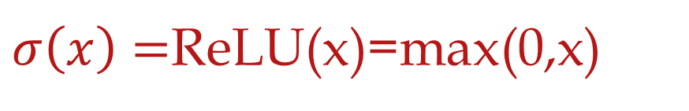
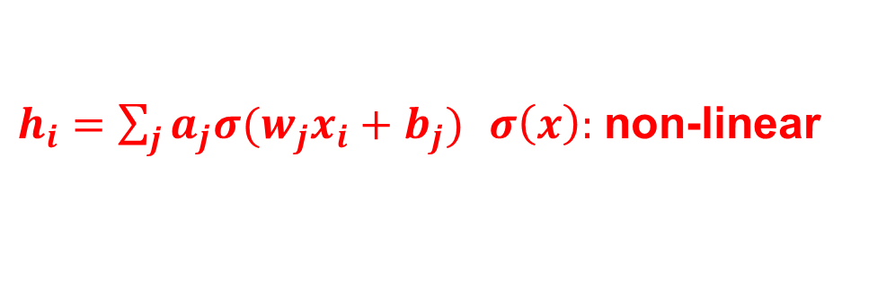
Neural network regression
$h_{i}=\sum_{j}{a_{j}σ(w_{j}x_{i}+b_{j})}$ $σ\left(x\right):$ non-linear
If we only have one neuron
$σ\left(x\right)=$ReLU(x)=max(0,x)
The output shape is restricted.

Slide 9
Neural network regression
Data set:
Model:
$h_{i}=\sum_{j}{a_{j}σ(w_{j}x_{i}+b_{j})}$ $σ\left(x\right):$ non-linear
Loss/Risk:
Empirical risk minimization:
$$\min_{w,b}{L_{S}}$$
Generalization error: loss on test data set (not for training)

Slide 10
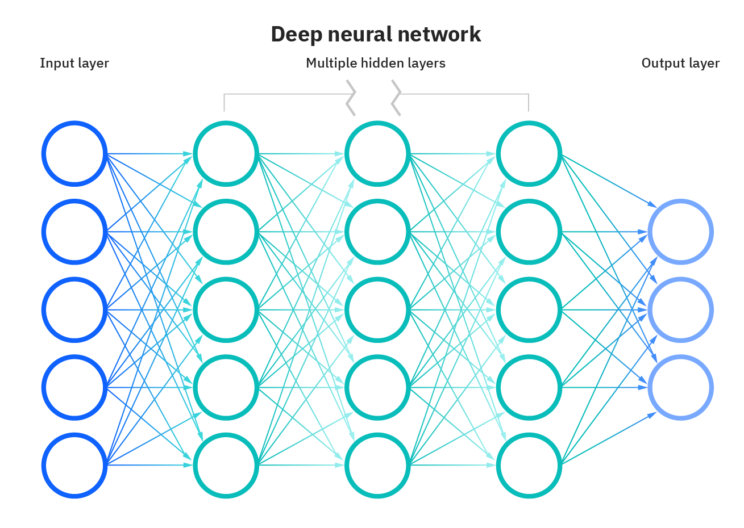
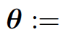
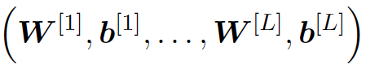
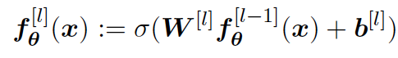

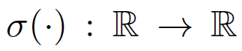
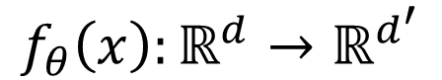
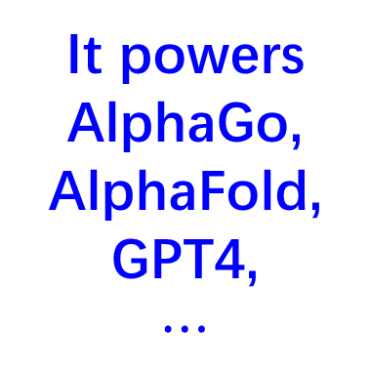
“Normal”Deep Neural Network（DNN）
It powers
AlphaGo, AlphaFold,
GPT4,
$$⋯$$
$$f_{θ}\left(x\right):ℝ^{d}→ℝ^{d^{′}}$$
https://www.ibm.com/cloud/learn/neural-networks

Slide 11
It is so powerful, why bother theory?

Slide 12
Why need theory for DNN
First law of thermodynamics: Conservation of energy
Perpetual motion machine of the first kind is impossible, avoid wasting energy
Chemistry
Alchemy, copper into gold impossible, avoid wasting energy
wood carbon into diamond (high temperature and pressure) possible
Understand what DNNs are good at and what is difficult for them
Example: High frequency is difficult
Question: Does emergence necessarily require large models and big data

Slide 13
Over-parameterization puzzle on generalization

Slide 14
Is NN really so complex?

Slide 15
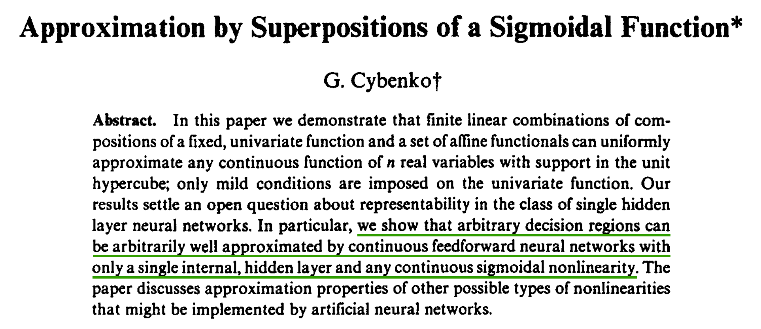
1989
Yes, NN is complex!

Slide 16
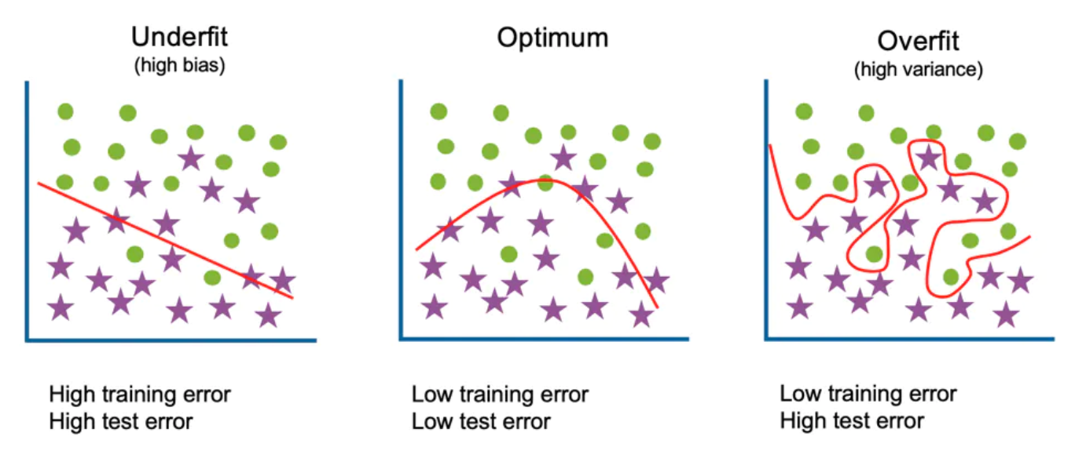
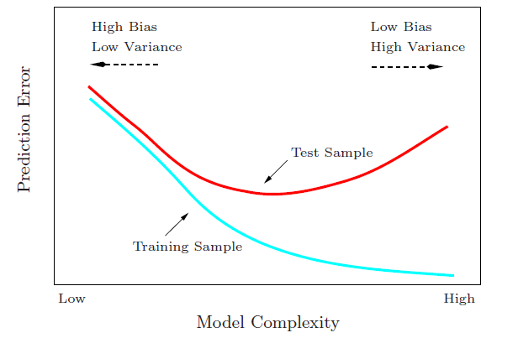
Start from traditional generalization gap
Large complexity → Large generalization gap
Generalization Gap
Traditional wisdom: Too complex is trouble

Slide 17
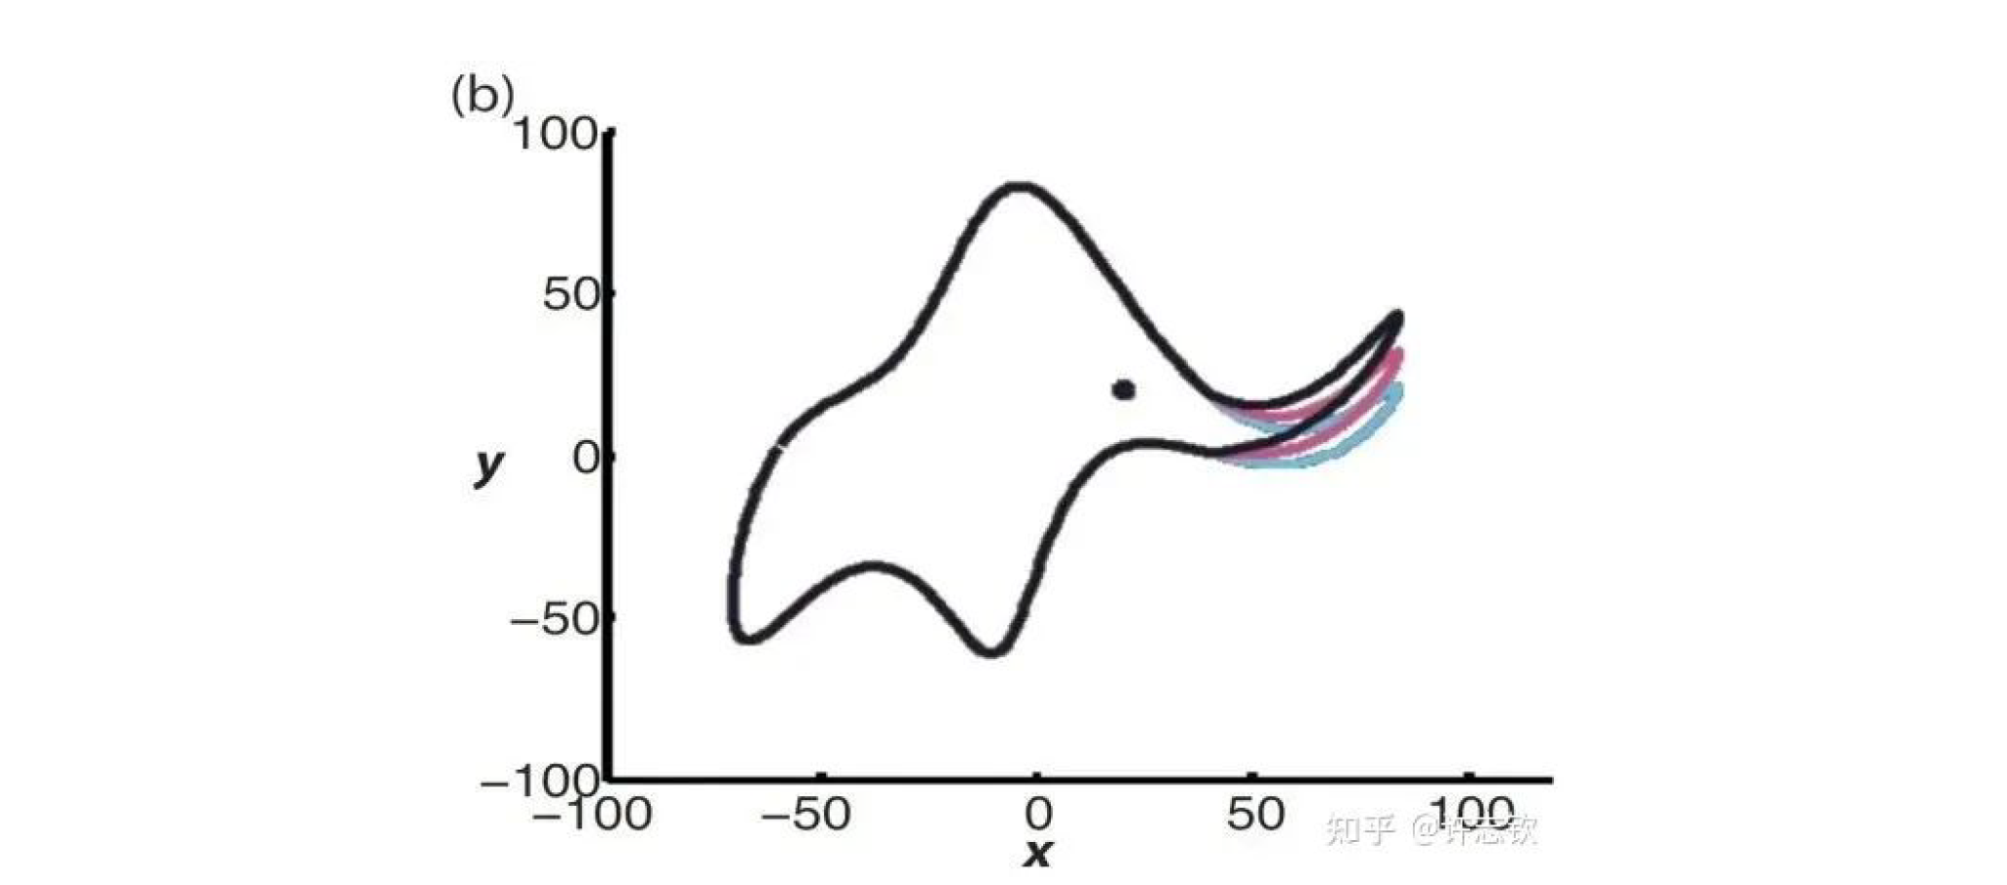
Simplicity is important
Von Neumann once said, "Give me four parameters and I can fit an elephant, give me one more and I can make the elephant move." (Dyson 2004)

Slide 18
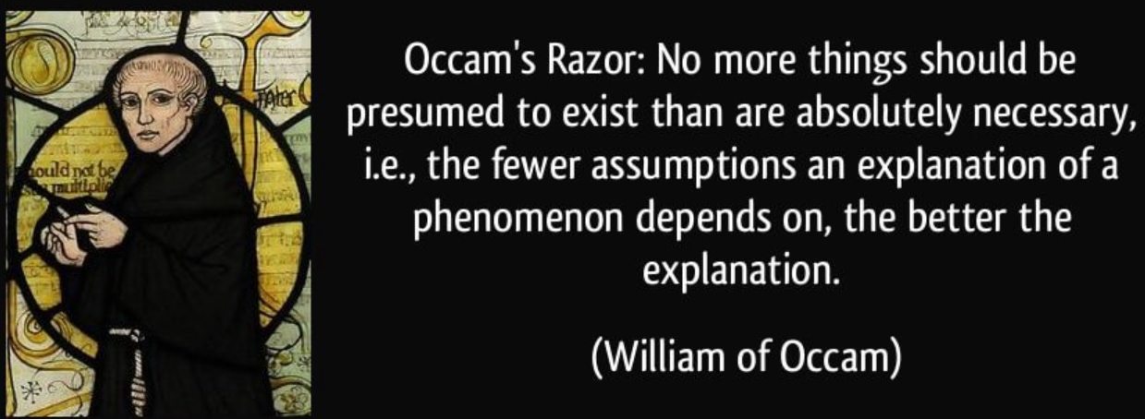
Simplicity is important

Slide 19
What about neural networks?

Slide 20
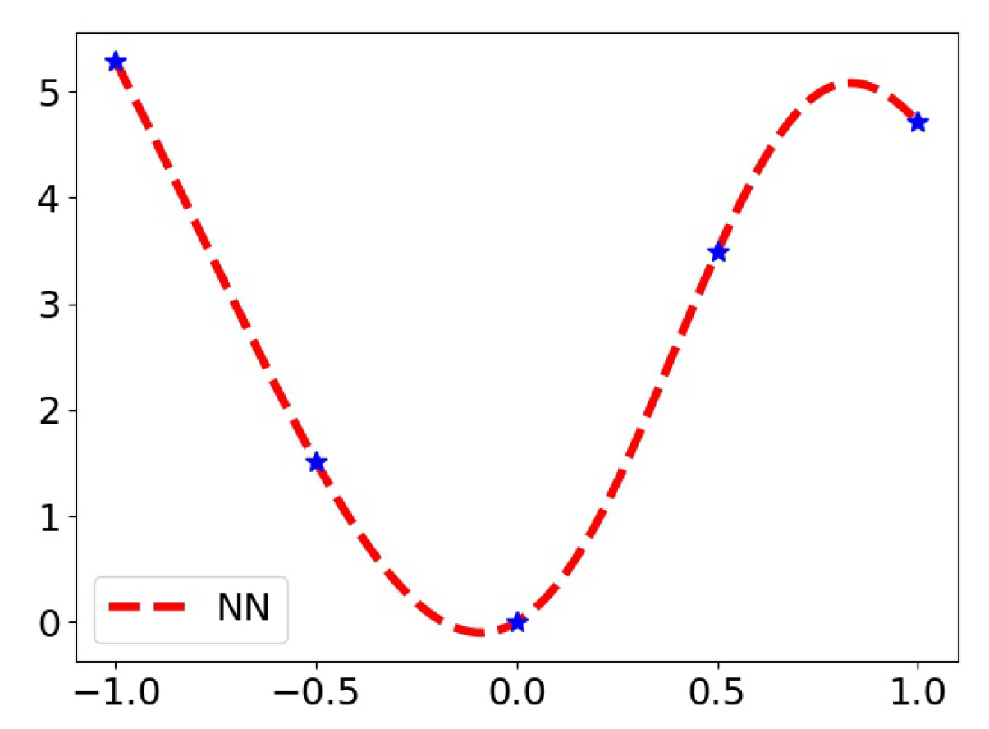
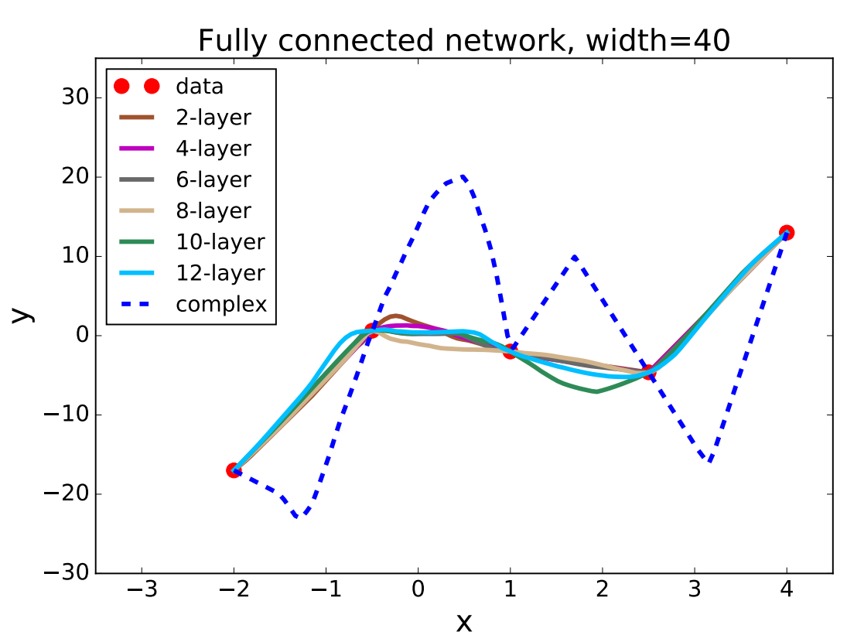
One dimensional fitting
# of parameters: ~ 1600*Layer number>>5
Four hidden layers with 500 neurons in each layer and the activation function Tanh.
Lei Wu et al., 2017

Slide 21
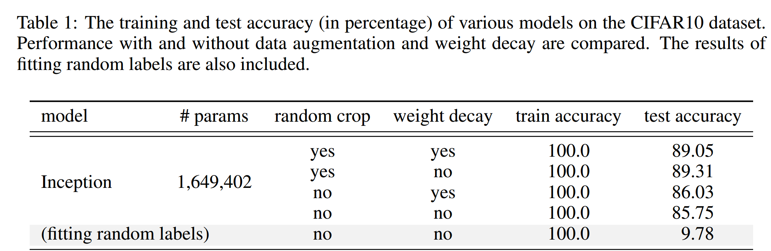
Overparameterization puzzle
Puzzle: generalize well even # of para >> # of training data
60000 32x32 colour images in 10 classes
This trouble ignores deep learning?
L. Breiman 1995, Zhang et al., 2016

Slide 22

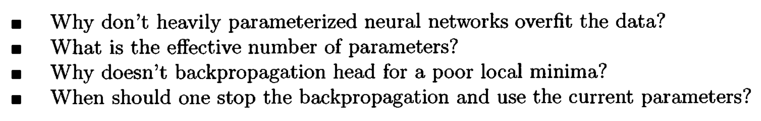
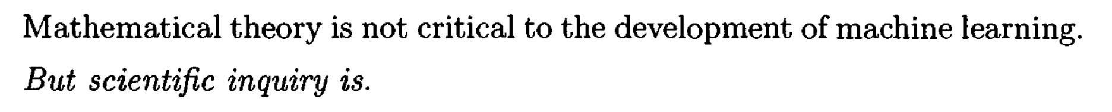
Long-standing problems
1995

Slide 23
This phenomenon inspires a series of subsequent works

Slide 24
Is NN really so complex?

Slide 25
Is NN really so complex?
in practice?

Slide 26
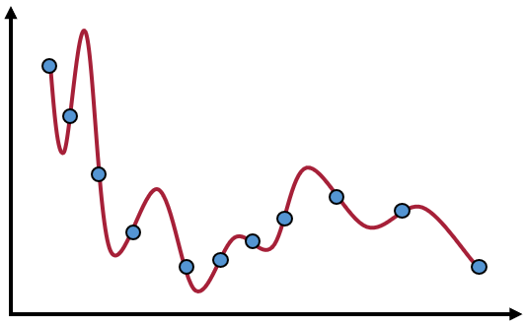
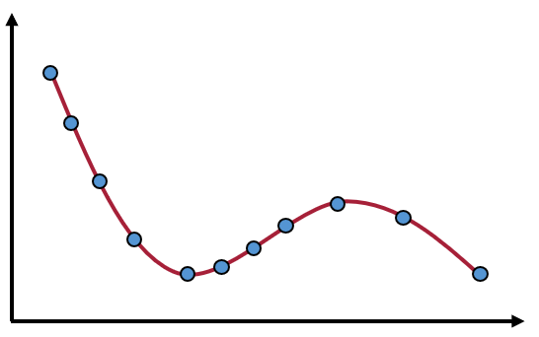
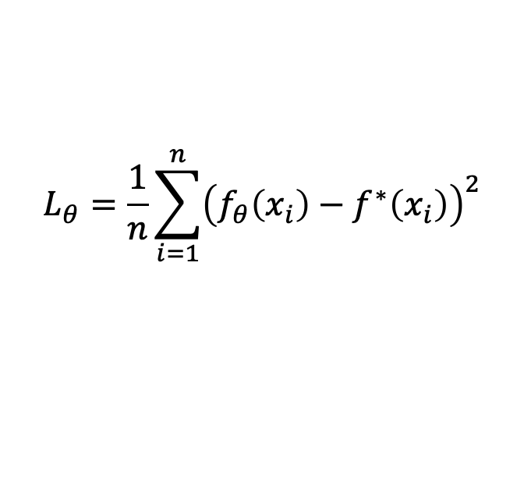
In our series：Implicit bias (regularization)
Loss=0：
……
Train
#para> #sample
Mul. Sol.
Sol. With good gen.
$$L_{θ}=\frac{1}{n}\sum_{i=1}^{n}{{\left(f_{θ}\left(x_{i}\right)−f^{∗}\left(x_{i}\right)\right)}^{2}}$$
But, no difference in loss function：
A key Question：
What is implicit bias of neural networks during training?

Slide 27
Implicit regularization
Regularization indicates what problems the model can better fit.
Traditional optimization
Explicit
Loss + L1/L2/…
Neural network
Implicit
All
Solution
initialization + loss + dynamics$\underset{⇔}{???}$loss+regularization
Notes:
下面，我们来解释隐式正则化的概念。在传统的优化中，很多时候满足损失函数最小的解有很多，许多研究工作会根据问题的特点添加正则化条件来确定解，比如对于稀疏问题，可以加L1，对于能量最小化问题可以添加L2。正则化条件不仅帮我们选择到唯一的解，重要的是它提供了一种可解释性，它决定了模型在何种问题可以有好的泛化性。
而在神经网络中，我们是通过选择初始化、损失函数的类型以及不同优化方法带来的训练动力学，最终从所有可行解中选择一个解。如果这些选择可以等价成一个损失函数加上正则化，那我们就可以通过这个正则化条件来理解神经网络在什么问题有好的泛化性，在什么问题有局限性。这个正则化由于不是显示地在训练过程中添加的，因此，也被称为隐式正则化。

Slide 28
Picture of deep learning with implicit bias
loss initialization dynamics
Low frequency interpolations
Linear regime
Non-Linear regime
Nearest
solution
Condensation
Global minima
Parameter space

Slide 29
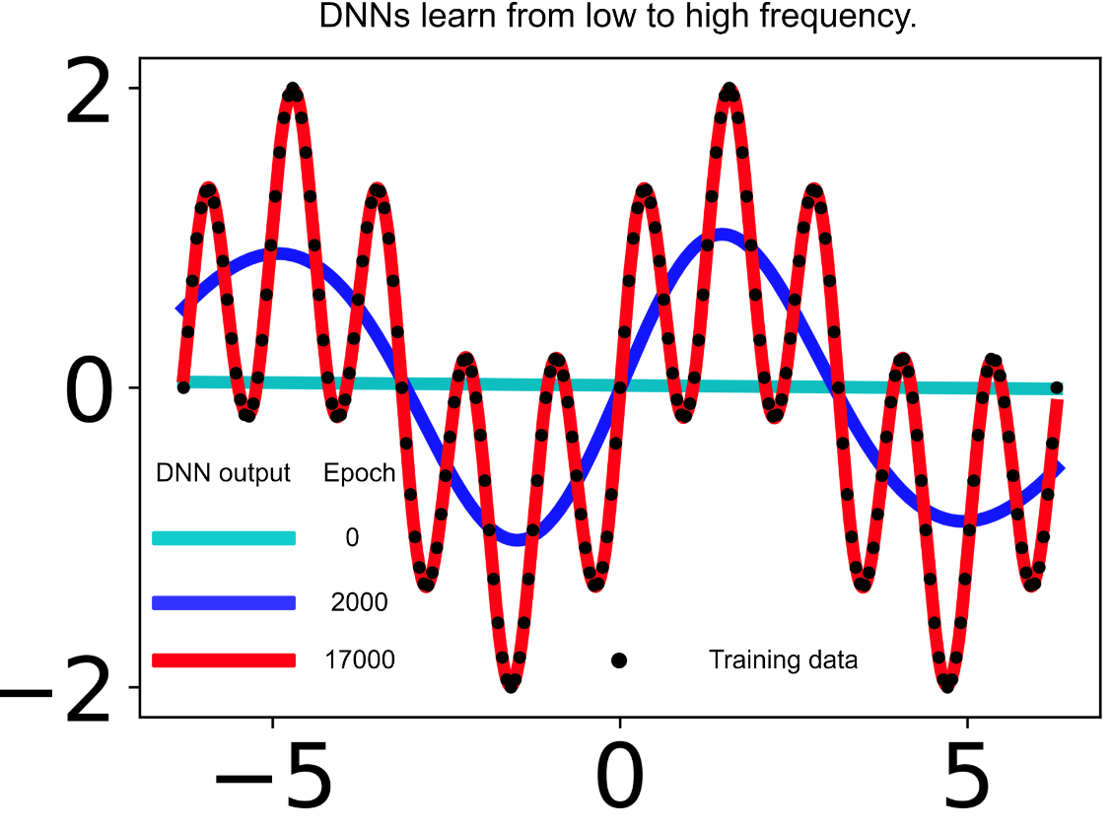
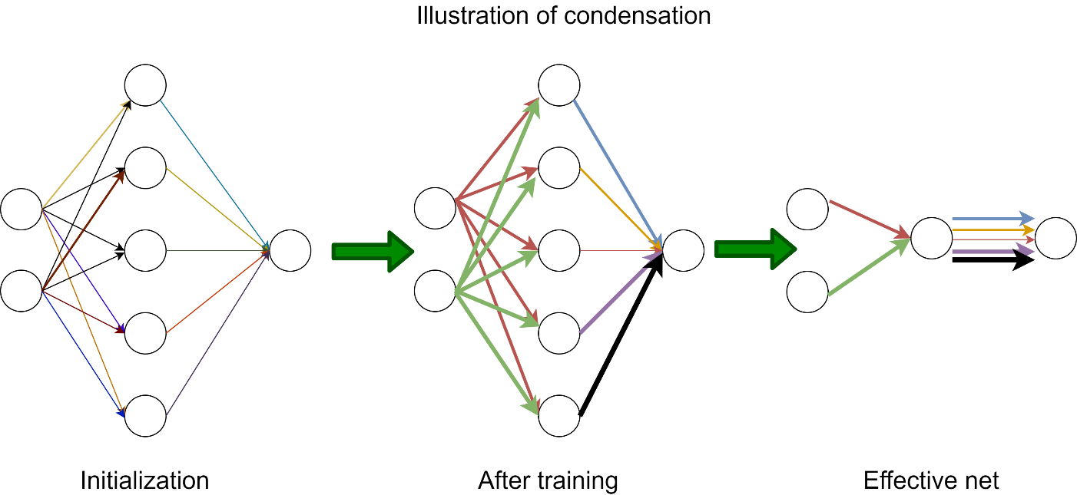
Simplicity bias in practice
Frequency Principle （频率原则）
Condensation
（参数凝聚）
Low-frequency bias
Few effective neurons

Slide 30
Frequency Principle/Spectral bias
Zhi-Qin John Xu*, Yaoyu Zhang, Tao Luo, Overview frequency principle/spectral bias in deep learning. Communications on Applied Mathematics and Computation 2024
Zhi-Qin John Xu* , Yaoyu Zhang, Tao Luo, Yanyang Xiao, Zheng Ma, Frequency Principle: Fourier Analysis Sheds Light on Deep Neural Networks, Communications in Computational Physics, 2020
Rahaman, Nasim, et al. "On the spectral bias of neural networks." International conference on machine learning. PMLR, 2019.
Zhi-Qin John Xu* , Yaoyu Zhang, and Yanyang Xiao, Training behavior of deep neural network in frequency domain, arXiv preprint: 1807.01251, (2018), 26th International Conference on Neural Information Processing (ICONIP 2019)

Slide 31
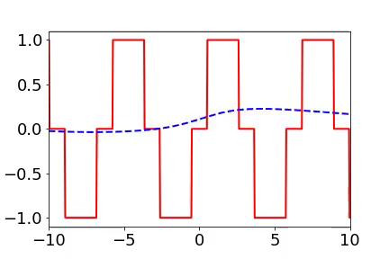
Training process of 1d example in spatial domain
From landscape to detail
Red:
target function
Blue:
DNN fitting
1807.01251

Slide 32
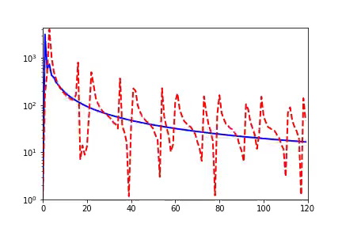
Training process of 1d example in Fourier domain
Frequency principle: From low frequency to high frequency
Red:
target function
Blue:
DNN fitting
Amplitude
Frequency

Slide 33
Neuron Condensation/Alignment
Tao Luo#, Zhi-Qin John Xu #, Zheng Ma, Yaoyu Zhang*, Phase diagram for two-layer ReLU neural networks at infinite-width limit, arxiv 2007.07497 (2020), Journal of Machine Learning Research (2021)
Yaoyu Zhang*, Zhongwang Zhang, Tao Luo, Zhi-Qin John Xu*, Embedding Principle of Loss Landscape of Deep Neural Networks. NeurIPS 2021 spotlight
[18] Hanxu Zhou, Qixuan Zhou, Tao Luo, Yaoyu Zhang*, Zhi-Qin John Xu*, Towards Understanding the Condensation of Neural Networks at Initial Training, NeurIPS2022.
Zhongwang Zhang, Zhi-Qin John Xu*, Implicit regularization of dropout. Transactions on Pattern Analysis and Machine Intelligence (TPAMI), 2024

Slide 34
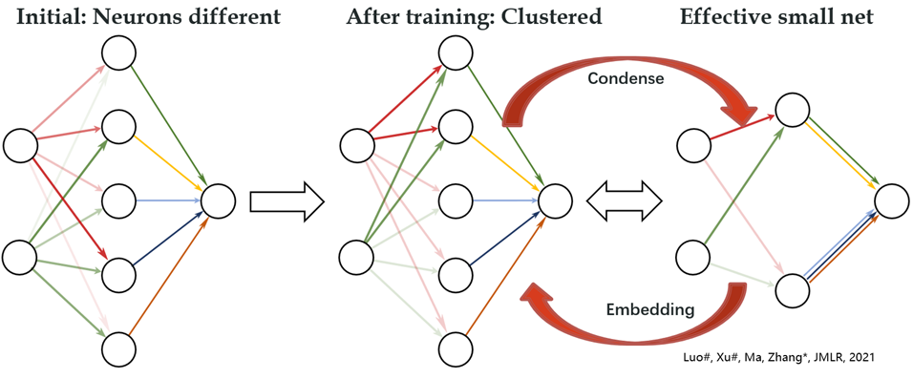

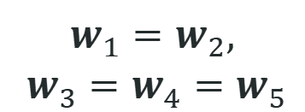
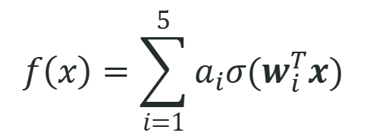
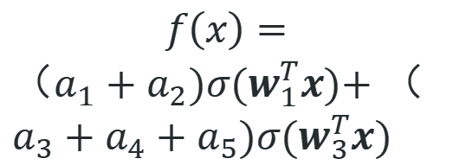
Condensation
$$f\left(x\right)=\sum_{i=1}^{5}{a_{i}σ(w_{i}^{T}x)}$$
$$f\left(x\right)=$$
$（a_{1}+a_{2})σ(w_{1}^{T}x)\text{+}$ $（a_{3}+a_{4}+a_{5})σ(w_{3}^{T}x)$
$$w_{1}^{ }=w_{2}^{ },$$
$${ w}_{3}^{ }=w_{4}^{ }=w_{5}^{ }$$
Initial：random
After training：
Condense
Effective：
Small net

Slide 35
Implicitly bias toward simple function
Advantage of frequency principle and condensation：
Rigorous theoretical analysis
Inspire more efficient algorithms
Simple but explain overparameterization puzzle
Traditional methods
(#para>#sample)
Neural networks
can
Bias towards
overfit
Simple
High-freq！
Large-complexity！
Low-freq！
Small effective neuron #！

Slide 36
More phenomena

Slide 37
Edge of stability

Slide 38
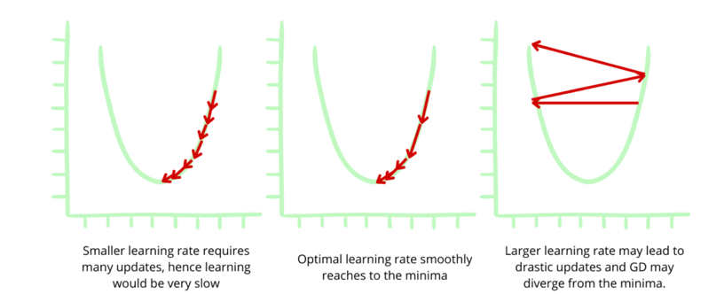
Stability and learning rate
https://www.enjoyalgorithms.com/blog/loss-and-cost-functions-in-machine-learning

Slide 39

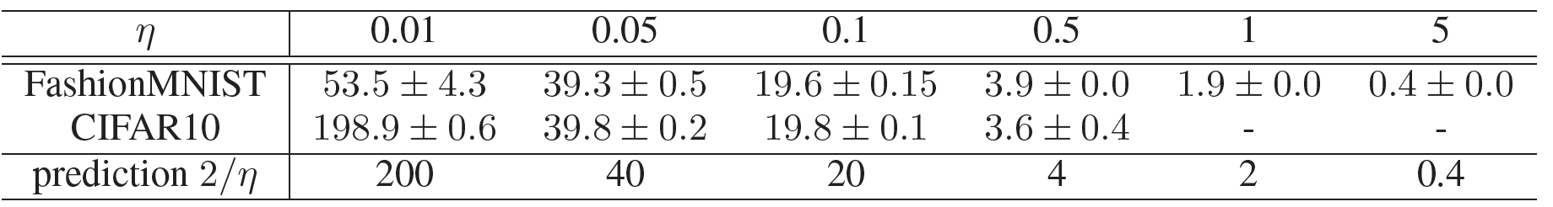
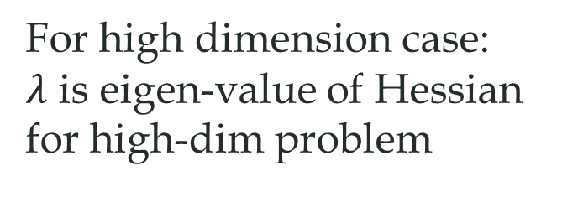
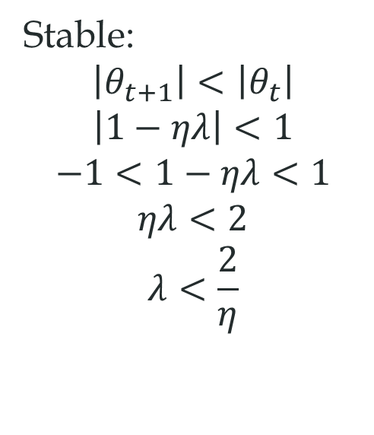
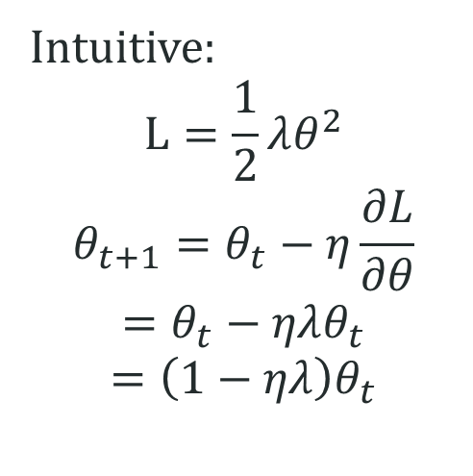
Edge of stability
Intuitive:
$$L=\frac{1}{2}λθ^{2}$$
$$θ_{t+1}=θ_{t}−η\frac{∂L}{∂θ}$$
$$=θ_{t}−ηλθ_{t}$$
$$=\left(1−ηλ\right)θ_{t}$$
Stable:
$$\left|θ_{t+1}\right|<\left|θ_{t}\right|$$
$$\left|1−ηλ\right|<1$$
$$−1<1−ηλ<1$$
$$ηλ<2$$
$$λ<\frac{2}{η}$$
For high dimension case:
$λ$ is eigen-value of Hessian for high-dim problem
Lei Wu, Chao Ma and Weinan E. "How sgd selects the global minima in over-parameterized learning: A dynamical stability perspective." Advances in Neural Information Processing Systems 31 (2018).

Slide 40
Flat solution and sharp solution

Slide 41
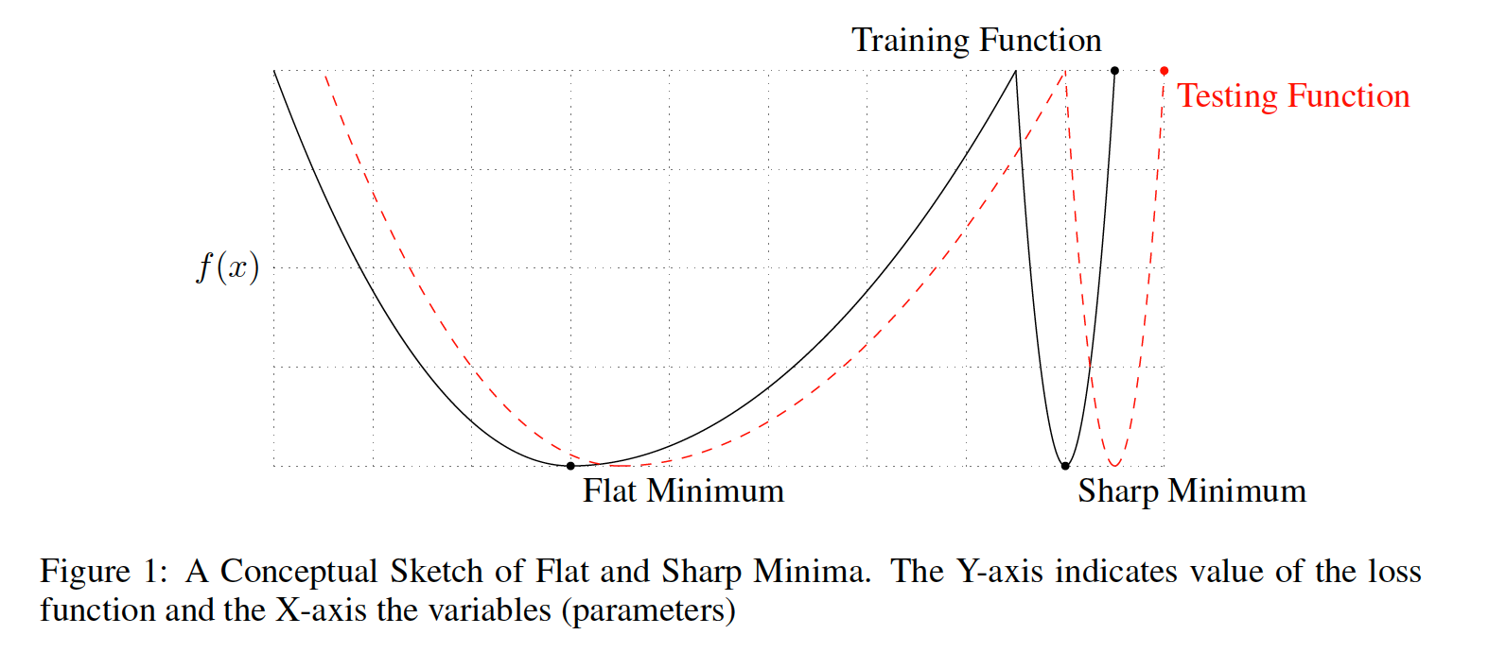
Sharpness effect
Keskar, Nitish Shirish, et al. "On Large-Batch Training for Deep Learning: Generalization Gap and Sharp Minima." International Conference on Learning Representations. 2016.

Slide 42
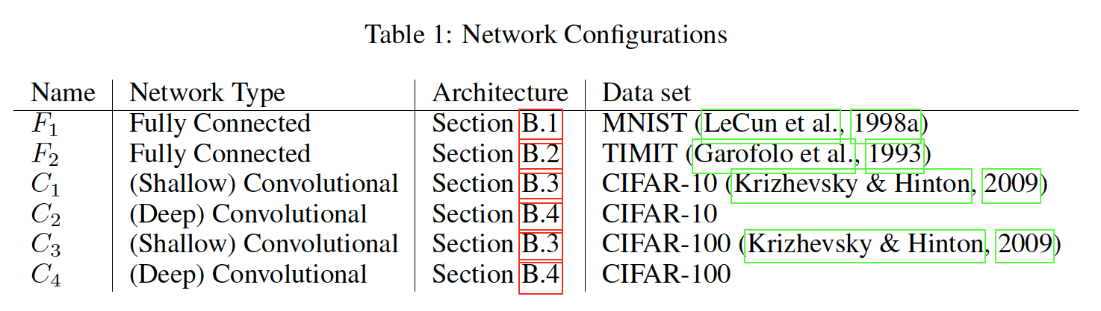
Experiment list
Keskar, Nitish Shirish, et al. "On Large-Batch Training for Deep Learning: Generalization Gap and Sharp Minima." International Conference on Learning Representations. 2016.

Slide 43
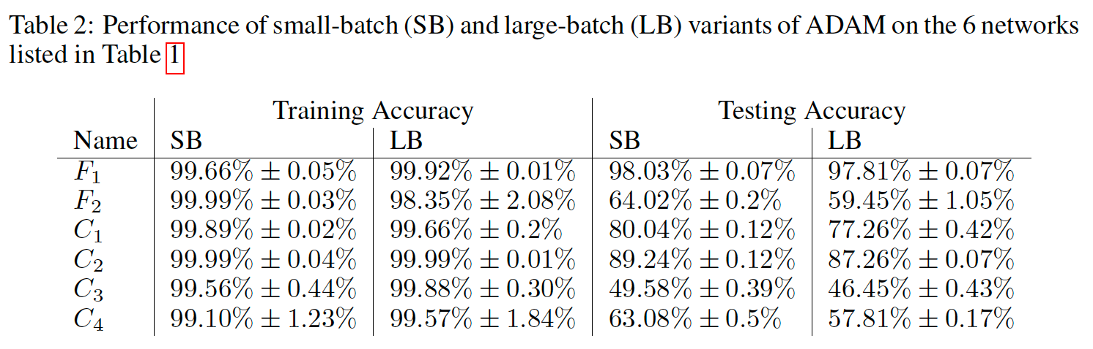
Experiment list
For all experiments, 10% of the training data are used as batch size for the large-batch experiments and 256 data points are used for small-batch experiments.
Keskar, Nitish Shirish, et al. "On Large-Batch Training for Deep Learning: Generalization Gap and Sharp Minima." International Conference on Learning Representations. 2016.

Slide 44
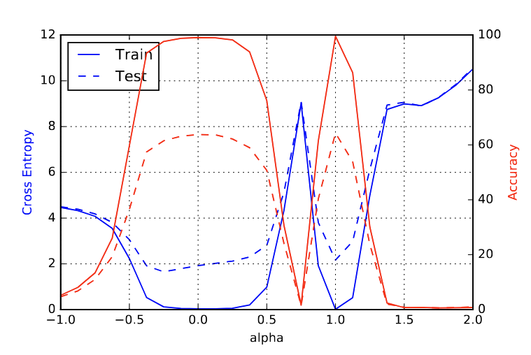
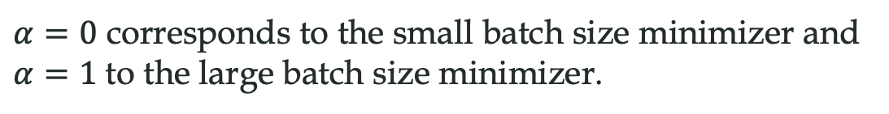
One dimension example
$α=0$ corresponds to the small batch size minimizer and $α=1$to the large batch size minimizer.
Keskar, Nitish Shirish, et al. "On Large-Batch Training for Deep Learning: Generalization Gap and Sharp Minima." International Conference on Learning Representations. 2016.

Slide 45
Noise structure in SGD

Slide 46
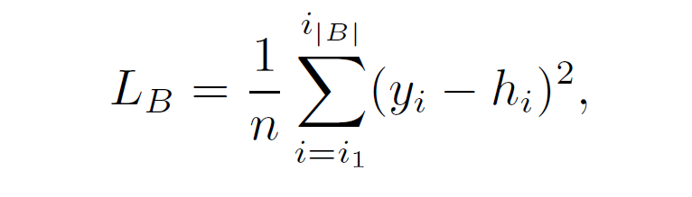

Stochastic gradient dynamics
GD：
SGD：

Slide 47


Stochastic gradient dynamics
SGD：
Langevin dynamics (GLD)：
Zhu, Zhanxing, et al. "The Anisotropic Noise in Stochastic Gradient Descent: Its Behavior of Escaping from Sharp Minima and Regularization Effects." International Conference on Machine Learning. PMLR, 2019.

Slide 48

Stochastic gradient dynamics
Left: SVHN Right: CIFAR-10 training on VGG-11 with different training dynamics
Special noise structure for stochastic gradient descent enhances model generalization ！
Zhu, Zhanxing, et al. "The Anisotropic Noise in Stochastic Gradient Descent: Its Behavior of Escaping from Sharp Minima and Regularization Effects." International Conference on Machine Learning. PMLR, 2019.

Slide 49





Relationship between the SGD noise and the flatness
$p_{i}$ is the eigendirection of i-th eigenvalue $σ_{i}^{2}$of the SGD noise matrix $Σ_{sgd}^{t}$
Feng, Yu, and Yuhai Tu. "The inverse variance–flatness relation in stochastic gradient descent is critical for finding flat minima." Proceedings of the National Academy of Sciences 118.9 (2021): e2015617118.

Slide 50


Relationship between the SGD noise and the flatness
Feng, Yu, and Yuhai Tu. "The inverse variance–flatness relation in stochastic gradient descent is critical for finding flat minima." Proceedings of the National Academy of Sciences 118.9 (2021): e2015617118.

Slide 51
Lottery ticket

Slide 52

Lottery ticket
https://towardsdatascience.com/saga-of-the-lottery-ticket-hypothesis-af30091f5cb

Slide 53

Lottery ticket
MNIST
Pruning: remove a percentage of the weights with the lowest magnitudes within each layer.
Frankle, Jonathan, and Michael Carbin. "The Lottery Ticket Hypothesis: Finding Sparse, Trainable Neural Networks." International Conference on Learning Representations.
Notes:
remove a percentage of the weights with the lowest magnitudes within each layer.

Slide 54
Double Descent

Slide 55
Traditional learning theory

Slide 56

Double Descent
Belkin, Mikhail, et al. "Reconciling modern machine-learning practice and the classical bias–variance trade-off." Proceedings of the National Academy of Sciences 116.32 (2019): 15849-15854.

Slide 57

Double Descent with label noise
Nakkiran, Preetum, et al. "Deep double descent: Where bigger models and more data hurt." Journal of Statistical Mechanics: Theory and Experiment 2021.12 (2021): 124003.

Slide 58
Grokking

Slide 59

Traditional learning theory

Slide 60


Grokking
Transformer
Power, Alethea, et al. "Grokking: Generalization beyond overfitting on small algorithmic datasets." arXiv preprint arXiv:2201.02177 (2022).

Slide 61


Grokking: frequency perspective
Dataset from $sin\left(6x\right)$:
Zhangchen Zhou, Yaoyu Zhang, Zhi-Qin John Xu*, A rationale from frequency perspective for grokking in training neural network. Arxiv 2405.03095

Slide 62

Zhangchen Zhou, Yaoyu Zhang, Zhi-Qin John Xu*, A rationale from frequency perspective for grokking in training neural network. Arxiv 2405.03095

Slide 63



Grokking: frequency perspective
More data that close to $sin⁡(x)$.
More data that are uniformly sampled from $sin⁡(6x)$.
s= 10,20,30,40 from deep to shallow
Zhangchen Zhou, Yaoyu Zhang, Zhi-Qin John Xu*, A rationale from frequency perspective for grokking in training neural network. Arxiv 2405.03095

Slide 64
Neural collapse

Slide 65
Neural collapse
Feature

Slide 66

Neural collapse
Han, X. Y., Vardan Papyan, and David L. Donoho. "Neural Collapse Under MSE Loss: Proximity to and Dynamics on the Central Path." International Conference on Learning Representations.
Simplex Equiangular Tight Frame

Slide 67
Mode connectivity

Slide 68

Loss landscape can be any pattern
I. Skorokhodov, M. Burtsev, 2019

Slide 69

Mode connectivity
Garipov, Timur, et al. "Loss surfaces, mode connectivity, and fast ensembling of dnns." Advances in neural information processing systems 31 (2018).

Slide 70
In context learning

Slide 71

In context learning
Dong, Qingxiu, et al. "A survey on in-context learning." arXiv preprint arXiv:2301.00234 (2022).

Slide 72

In context learning
Dong, Qingxiu, et al. "A survey on in-context learning." arXiv preprint arXiv:2301.00234 (2022).

Slide 73
Chain of Thought (CoT)

Slide 74

Chain of Thought
Wei, Jason, et al. "Chain-of-thought prompting elicits reasoning in large language models." Advances in neural information processing systems 35 (2022): 24824-24837.

Slide 76


Han, X. Y., Vardan Papyan, and David L. Donoho. "Neural Collapse Under MSE Loss: Proximity to and Dynamics on the Central Path." International Conference on Learning Representations.

Slide 77
As you may have known! Chinese students are pretty good at English. We can recite text book very well!

Slide 78

Here is an example!
Once upon a time, a man falls into a deep well.

Slide 79

Here is an example!
A man comes and asks
how are you?

Slide 80
Here is an example!
…………..Fine! Thank you, and you?

Slide 81


Implicit regularization of SGD
$L(θ)$ is the loss function, $∇L\left(θ\right)$ is its gradient, $η$ is learning rate, $m$ is the number of the mini-batch, $\hat{L_{i}}(θ)$ is the loss of the i-th mini-batch, then the implicit regularization reads:
Implicit regularization: minimize the variance between $∇\hat{L_{i}}(θ)$
Smith, Samuel L., et al. "On the Origin of Implicit Regularization in Stochastic Gradient Descent." International Conference on Learning Representations.

Slide 82
Here is an example!
Keeps deep Learning to find a way out!

Slide 83


My most work is to find a way out.
Keeps deep Learning to find a way out!
Jump Prob~$\exp{(−ΔE/k_{b}T)}$

